Slide 1
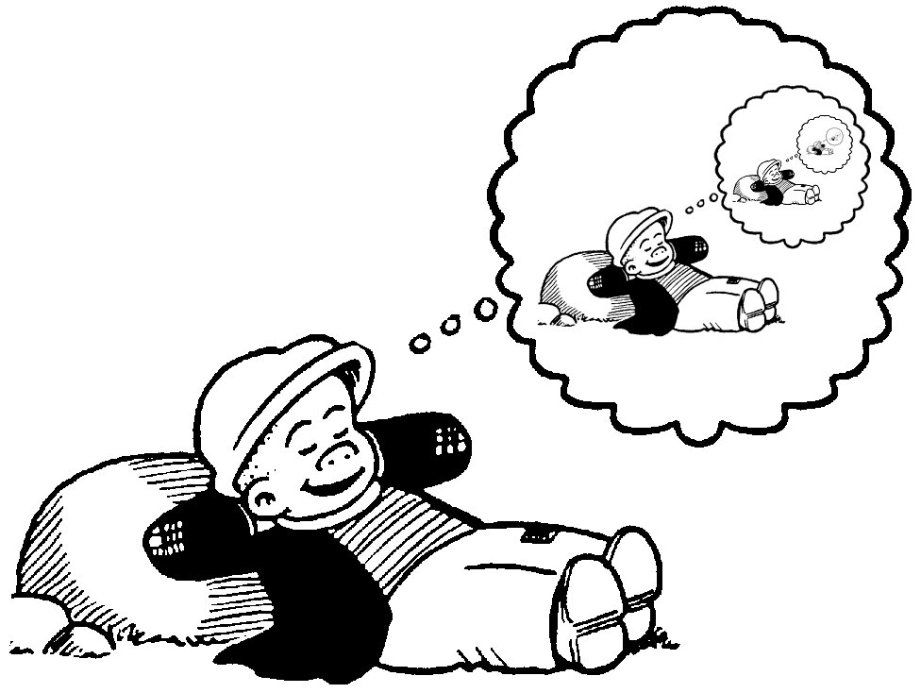
Recursive Definitions
Discrete Structures (CS 173)
Madhusudan Parthasarathy, University of Illinois

Slide 2
Today’s lecture: Recursive Definitions
Be able to write a series as a recursive function
Be able to “unroll” a recursive function and find the closed form
Prove closed form of recursive function using induction
Examples, including divide and conquer algorithm

Slide 3
Puzzle

Slide 4
False induction proofs
All horses in any field are of the same color.
Other good examples: http://www.math.uiuc.edu/~hildebr/347/induction3-sol.pdf
overhead

Slide 5
Program verification

Slide 6
Defining recursive functions
A recursive function has two parts:
base case: $f\left(1\right)=1$
recursive formula: $f\left(n\right)=f\left(n−1\right)+n$, for n $≥2$
Example:
$f\left(n\right)=\sum_{i=1}^{n}{i=1+2+3+…+n}$
$f\left(1\right)=1$ ← base case
$f\left(n\right)=f\left(n−1\right)+n$ ← recursive formula

Slide 7
Examples
$$f\left(n\right)=\sum_{k=1}^{n}{k(k−1)}$$

Slide 8
Fibonacci series

Slide 11
Examples
The series: 1, 2, 2, 4, 8, 32, 64, …
(each number is the product of previous two)

Slide 12
Finding closed form
$f\left(1\right)=1$
$f\left(n\right)=2f\left(n−1\right)+3, n≥2$

Slide 14
Process for finding closed form
“Unroll” $f(n)$ for several steps until the pattern becomes clear
Solve for $f(n−k)$
Find $k$ for base case
Substitute value for base case
Simplify
Check answer

Slide 15
Example: how many edges in a N-d hypercube?

Slide 16
Example of finding closed form
$f\left(0\right)=2$
$f\left(1\right)=3$
$f\left(n\right)=3f\left(n−1\right)−2f\left(n−2\right), ∀n≥2$

Slide 17
Proof of closed form solution by induction
$f\left(0\right)=2$
$f\left(1\right)=3$
$f\left(n\right)=3f\left(n−1\right)−2f\left(n−2\right), ∀n≥2$
Claim: For all natural $n$, $f\left(n\right)=2^{n}+1$

Slide 18
Example: divide and conquer computation
A divide and conquer algorithm recursively splits a problem of size $n$ into two smaller problems, each of size $n/2$.
Suppose it costs $n$ time to make the split and when $n=1$ the function returns a value in constant time $c$.
Problem: Write cost as a recursive function $S(n)$, solve for closed form, and prove that solution is correct.

Slide 20
Things to remember
Be able to write a series as a recursive function
Process for finding closed form
Unroll for several steps
Write in terms of $n−k$
Substitute for value of $k$ that is base case
Substitute base case value(s) and solve
Closed form solutions can be proved with induction

Slide 21
Next week
Trees

